Slide 1

Differential Expression Analysis
Center for Health Data Science

Slide 2
Agenda
Data correction and normalization
RPKM/FPKM-TPM-DESeq2
Exploratory analysis
PCA, Pearson correlation,
distance heatmaps
Workflow
Differential Expression Analysis
Comparison between conditions
Functional analysis
Gene-gene correlation
Networks
GO term

Slide 3
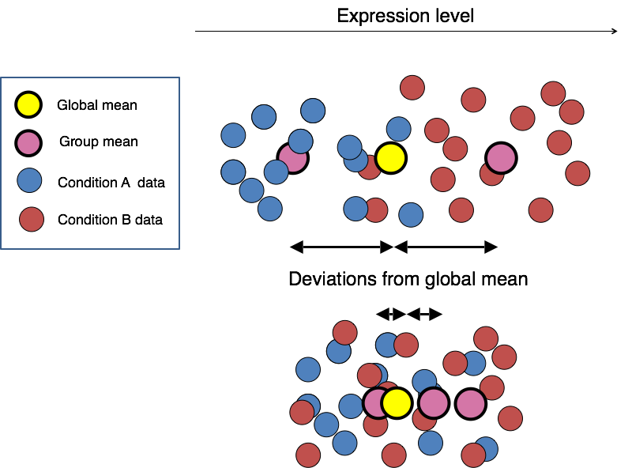
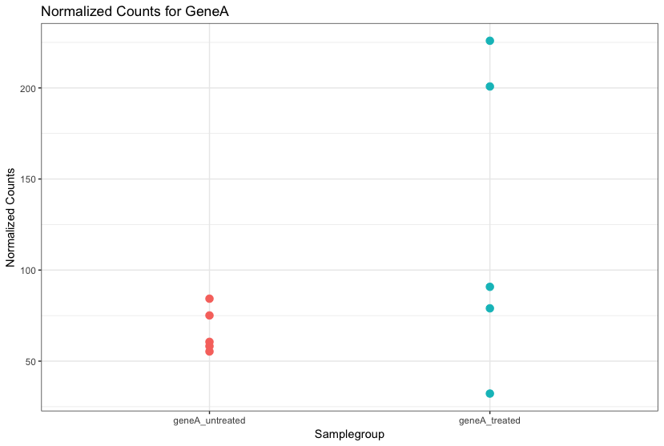
Differential Expression Analysis (DEA)
Ultimate goal of RNAseq is to compare expression between conditions
Significant
Not significant

Slide 4
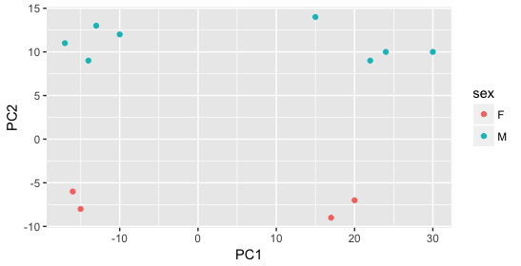
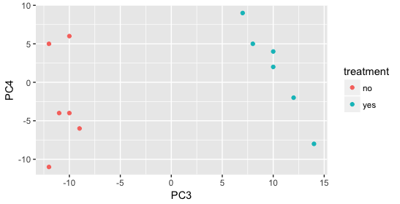
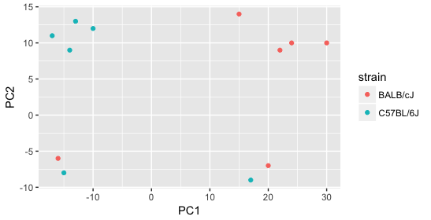
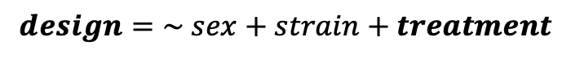
Differential Expression Analysis (DEA)
Define sources of variation for DE testing: design formula
Metadata variables that defined PCs in your PCA
Your variable of interest as well
Model counts and perform statistical test
$$design=\sim sex+strain+treatment$$

Slide 5
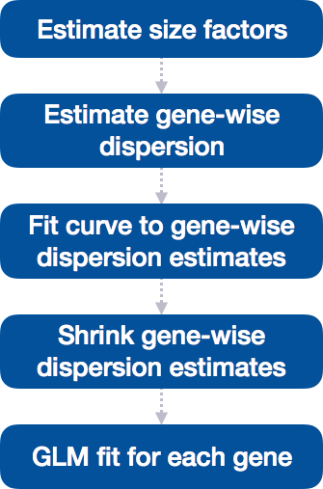
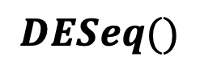
Differential Expression Analysis (DEA)
Define sources of variation for testing
DESeq2 Differential Gene Expression workflow
Three steps:
Estimate size factors (same as normalization!)
Estimate gene-wise dispersion
Fit Negative Binomial Generalized Linear Model
1
$$DESeq()$$
2
3

Slide 6
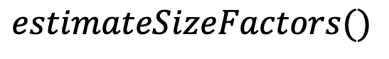
Differential Expression Analysis (DEA)
Estimate size factors
Same as normalization
Size factors are parameters used in the GLM
$$estimateSizeFactors()$$
1
2
3

Slide 7
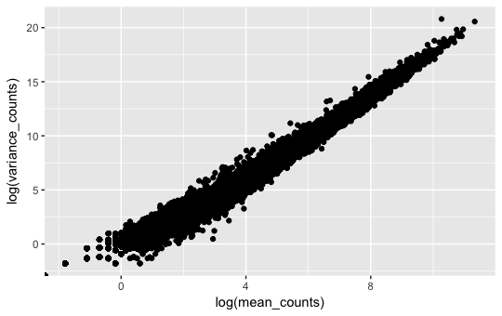
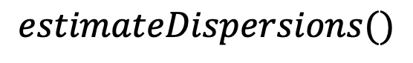
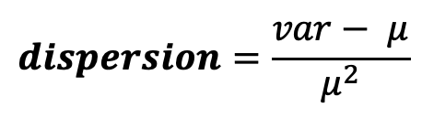
Differential Expression Analysis (DEA)
Estimate gene-wise dispersion
To estimate DEG → to account for replicate variation
Replicate variation → account for dispersion
$$estimateDispersions()$$
$$dispersion=\frac{var− μ}{μ^{2}}$$
1
2
3

Slide 8
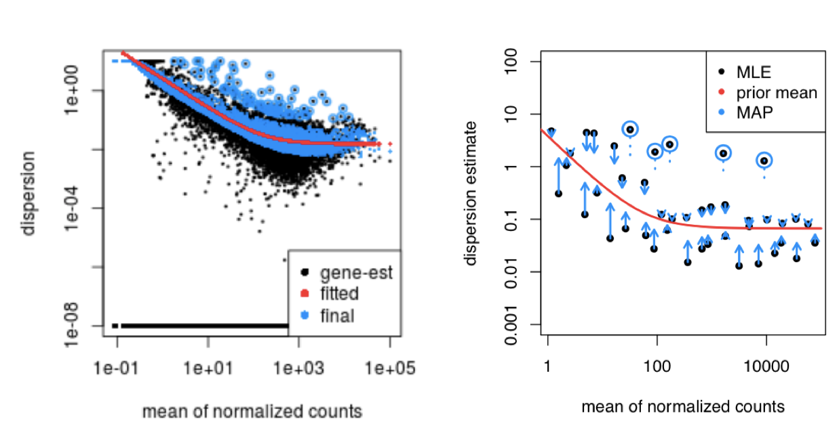
Differential Expression Analysis (DEA)
Estimate gene-wise dispersion
Dispersion is adjusted for low dispersed genes
$$estimateDispersions()$$
$$dispersion=\frac{var− μ}{μ^{2}}$$
1
2
3

Slide 9
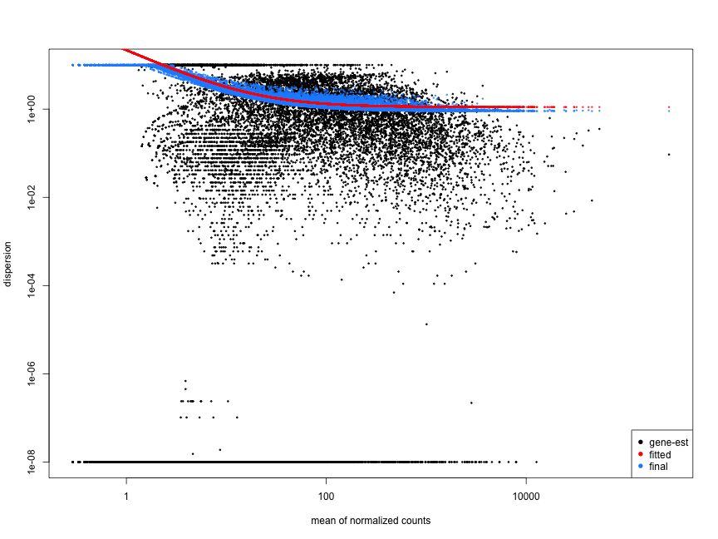
Differential Expression Analysis (DEA)
Estimate gene-wise dispersion
Worrisome dispersions
$$estimateDispersions()$$
$$dispersion=\frac{var− μ}{μ^{2}}$$
1
Bad fit!
2
3

Slide 10
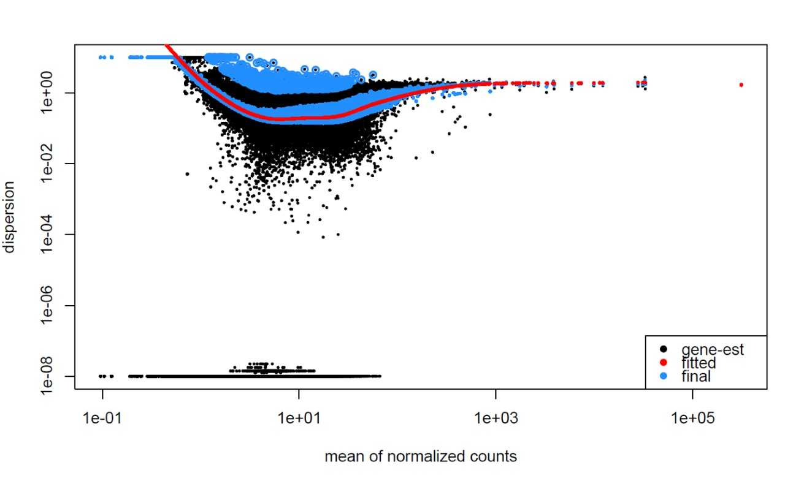
Differential Expression Analysis (DEA)
Estimate gene-wise dispersion
Worrisome dispersions
$$estimateDispersions()$$
$$dispersion=\frac{var− μ}{μ^{2}}$$
1
2
Outlier or contamination?
3

Slide 11
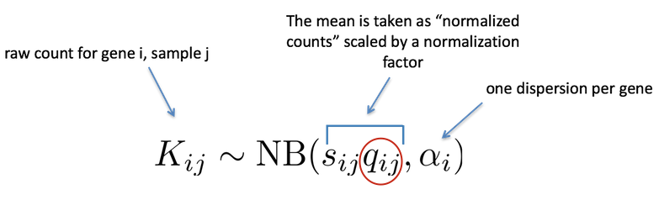
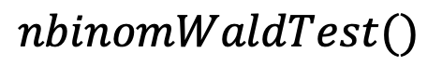
Differential Expression Analysis (DEA)
Fit a Negative Binomial – GLM and Wald test
Statistical testing needs to account for dispersion and size factor
Model’s coefficients are used for statistical testing and fold changes
$$nbinomWaldTest()$$
1
2
3

Slide 12
Differential Expression Analysis (DEA)
Let’s do run Differential Expression Analysis!

Slide 13
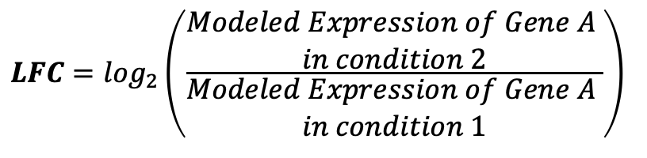
Differential Expression Analysis (DEA)
Calculation of Log₂ Fold Changes (LFC) and their statistical significance
Fold change: ratio of mean expression levels between conditions
How big the change is
Wald test P-value: probability of observing the fold change if it was due by chance
How significant the change is
$$LFC=\log_{2}\left(\frac{\begin{aligned}Modeled Expression of Gene A \\ in condition 2\end{aligned}}{\begin{aligned}Modeled Expression of Gene A \\ in condition 1\end{aligned}}\right)$$

Slide 14
Differential Expression Analysis (DEA)
What conditions you want to compare → Contrast
Simple experiments are easy to compare, e.g. Treated cells vs Control
More complicated experiments will need to establish proper comparisons:
Using different cell lines
Using multiple conditions/treatments
Samples from different patients

Slide 15
Differential Expression Analysis (DEA)
We need to correct for multiple testing
Since we are testing thousands of genes, the changes of false positives is high
Use Bonferroni correction for adjusted p-values
Filter significant DE between conditions
Absolute LFC > 1 ( >1 or < -1), adjusted p-value < 0.05
Visualization with volcano plots, heatmaps and MA plots

Slide 16
Differential Expression Analysis (DEA)
Let’s check out DEA results!

Slide 17
DEA visualization. MA plot
X-axis: mean expression of gene
How strongly expressed a gene is
Y-axis: LFC
Difference between condition B/A
LFC from low count genes are very noisy
2/1 != 200/100
LFC from low count genes can be “shrunk” for better visualization

Slide 18
DEA visualization. LFC Shrinkage
Much easier to interpret!!
MA plot without Shrinkage
MA plot after Shrinkage

Slide 19
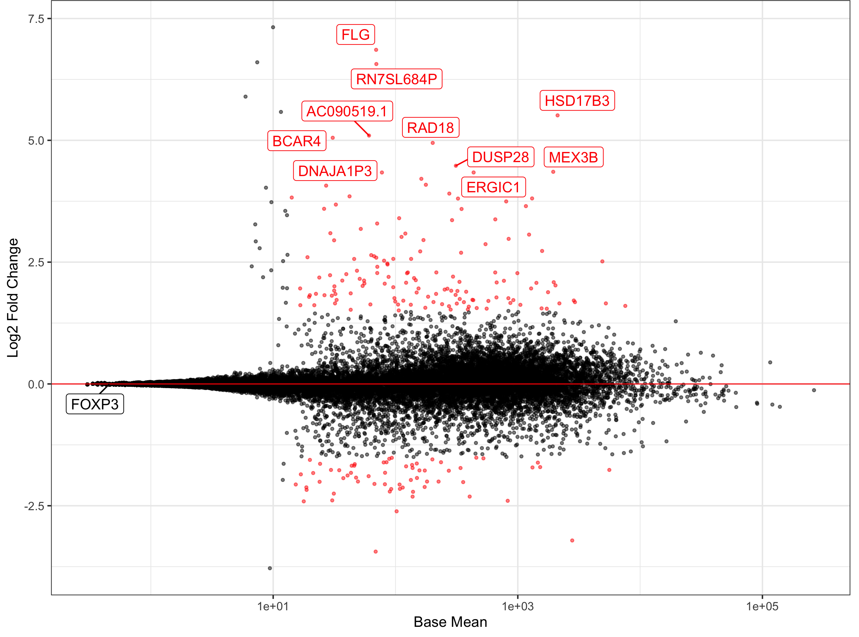
DEA visualization
MA plot
Genes more expressed
in treated cells (LFC > 1)
Volcano plot
Log₂ Fold Change
-Log₁₀(Adjusted p-value)
Base mean
Genes more expressed
in untreated cells (LFC < 1)
Log₂ Fold Change

Slide 20
DEA visualization
Heatmap of expression
Showing UP regulated genes (LFC > 1)
in stimulated vs untreated cells
Maybe you can select a set of genes you are interested in!

Slide 21
DEA visualization
Let’s visualize our DEA results!

Slide 22
DEA. Contrast designs
2
3
Three factors, with nesting
Conclusions
One factor, two levels
1
One factor, three levels
Two factors, with interaction
4
5
Hugo Tavares. University of Cambridge. @tavareshugo

Slide 23
One factor, two levels
Design → Effect of Treatment
Des = ~ 1 + condition
Expression = Intercept + Effect of Condition
Exp = 𝛽₀ + 𝛽₁ CondTreat
Condition
Samples | Condition <factor>
Control1 | Control
Control2 | Control
Control3 | Control
Treatment1 | Treatment
Treatment2 | Treatment
Treatment3 | Treatment
Model/Contrast matrix
Control
Treated
Samples | Intercept | Condition
Control1 | 1 | 0
Control2 | 1 | 0
Control3 | 1 | 0
Treatment1 | 1 | 1
Treatment2 | 1 | 1
Treatment3 | 1 | 1
One hot coding
Coefficients from DESeq:
𝛽₀ = Intercept
𝛽₁ = cond_Treat_vs_Control
𝛽₁
Expression
𝛽₀
Null hypothesis: 𝛽₁ = 0
Control
Treat

Slide 24
One factor, two levels
Design → Effect of Treatment
Des = ~ 0 + condition
Exp = 𝛽₀Control + 𝛽₁ Treat
Condition
Samples | Condition <factor>
Control1 | Control
Control2 | Control
Control3 | Control
Treatment1 | Treatment
Treatment2 | Treatment
Treatment3 | Treatment
Model/Contrast matrix
Control
Treated
Samples | Condition Control | Condition Treat
Control1 | 1 | 0
Control2 | 1 | 0
Control3 | 1 | 0
Treatment1 | 0 | 1
Treatment2 | 0 | 1
Treatment3 | 0 | 1
One hot coding
Null hypothesis:
𝛽₁ - 𝛽₀ = 0
𝛽₁
Expression
𝛽₀
Control
Treat

Slide 25
One factor, three levels
Design : ~ 1 + condition
Exp = 𝛽₀ + 𝛽₁CondTreat1 + 𝛽₂CondTreat2
Condition
Samples | Condition <factor>
Control1 | Control
Control2 | Control
Control3 | Control
Treat1_1 | Treat1
Treat1_2 | Treat1
Treat1_3 | Treat1
Treat2_1 | Treat2
Treat2_2 | Treat2
Treat2_3 | Treat2
Control
Treat1
Treat2
Model/Contrast matrix
Coefficients from DESeq:
𝛽₀ = Intercept
𝛽₁ = cond_Treat1_vs_Control
𝛽₂ = cond_Treat2_vs_Control
Samples | Intercept | CondTreat1 | CondTreat2
Control1 | 1 | 0 | 0
Control2 | 1 | 0 | 0
Control3 | 1 | 0 | 0
Treat1_1 | 1 | 1 | 0
Treat1_2 | 1 | 1 | 0
Treat1_3 | 1 | 1 | 0
Treat2_1 | 1 | 0 | 1
Treat2_2 | 1 | 0 | 1
Treat2_3 | 1 | 0 | 1
One hot coding
Null hypothesis:
Treat1 vs Control: 𝛽₁ = 0
Treat2 vs Control: 𝛽₂ = 0
Treat2 vs Treat1: 𝛽₁ - 𝛽₂ = 0
𝛽₁
Expression
𝛽₂
𝛽₀

Slide 26
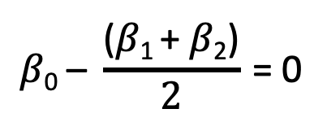
One factor, three levels
What if we wanted to compare the effect of any treatment vs control?
Design is the same: ~ 1 + condition
We should not combine treatments
together!
They are not replicates
Inflated/deflated estimates
Null hypothesis for Treats vs Control:
Condition
Model/Contrast matrix
Samples | Intercept | CondTreat
Control1 | 1 | 0
Control2 | 1 | 0
Control3 | 1 | 0
Treat1_1 | 1 | 1
Treat1_2 | 1 | 1
Treat1_3 | 1 | 1
Treat2_1 | 1 | 1
Treat2_2 | 1 | 1
Treat2_3 | 1 | 1
Control
Treat1
Treat2
Control
Treat
Treat
𝛽₁
$$\text{β}\text{0}\text{ –} \frac{\text{(}\text{β}\text{1 }\text{+ }\text{β}\text{2}\text{)}}{2} \text{= 0}$$
Expression
𝛽₂
𝛽₀

Slide 27
Two factors, with interaction
Control
Treat
Design :
~ 1 + celltype + condition + celltype: condition
Condition
Coefficients from DESeq:
𝛽₀ = Intercept
𝛽₁ = celltype_CellB_vs_CellA
𝛽₂ = condition_Treat_vs_Control
𝛽₃ = celltypeCellB.conditionTreat
Celltype
A
B
Samples | Intercept | CondTreat1 | CellB
Control1_A | 1 | 0 | 0
Control2_A | 1 | 0 | 0
Control3_A | 1 | 0 | 0
Control1_B | 1 | 1 | 1
Control1_B | 1 | 1 | 1
Control1_B | 1 | 1 | 1
Treat1_A | 1 | 1 | 0
Treat2_A | 1 | 1 | 0
… | … | … | …
𝛽₃
Expression
Null hypothesis:
Cell B vs Cell A (Control): 𝛽₁ = 0
Cell B vs Cell A (Treat): 𝛽₁ + 𝛽₃ = 0
Treat vs Control (Cell A): 𝛽₂ = 0
Treat vs Control (Cell B): 𝛽₂ + 𝛽₃ = 0
Interaction: 𝛽₃ = 0
𝛽₁
𝛽₂
Model/Contrast matrix
𝛽₀

Slide 28
Three factors, with nesting
Control
Treat
We see that Patient is “nested” in Celltype
Patient should not be included in the design!
Including Patient into the design might over- or underestimate errors!
We need to adjust for the nested factor:
Increased Type I errors
Loss of power
Condition
Celltype
A
B
C
D
Design :
~ 1 + celltype + condition + celltype: condition
Patient
1
2
B
B
Expression
A
A

Slide 29
Conclusions
Using model matrix gives a consistent way to define contrasts of interest
Works for imbalanced and/or nested designs (weights coefficients correctly)
It can be applied in other cases
Similar approach with `R/emmeans` package (for extracting estimated means from linear models)
It works similarly with edgeR and limma packages
However:
Using DESeq coefficients is less verbose
This approach is limited to factors, for continuous predictors it doesn’t really work

